Slide 1
Day 5
Intro to phylogenomics
Installation of hybpiper and phylogenetics software
Coffee break
Hybpiper tutorial
Lunch break
Alignments, gene trees and species tree

Slide 2
Intro to phylogenomics: see separate power point

Slide 3
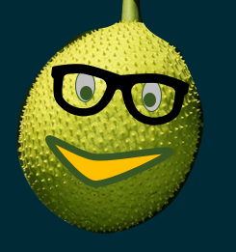

Kopi Break !

Slide 4
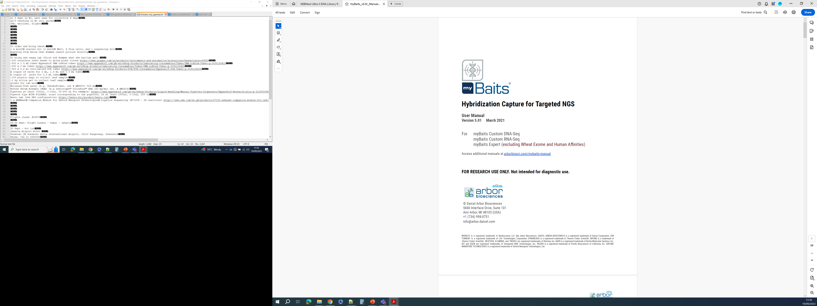
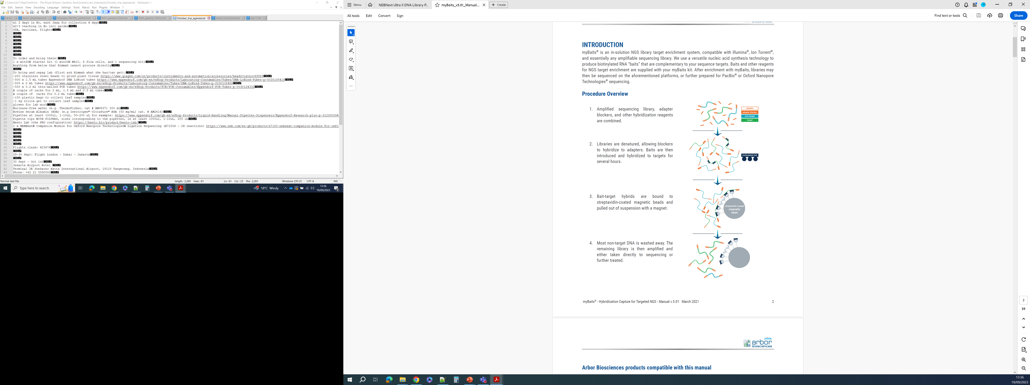
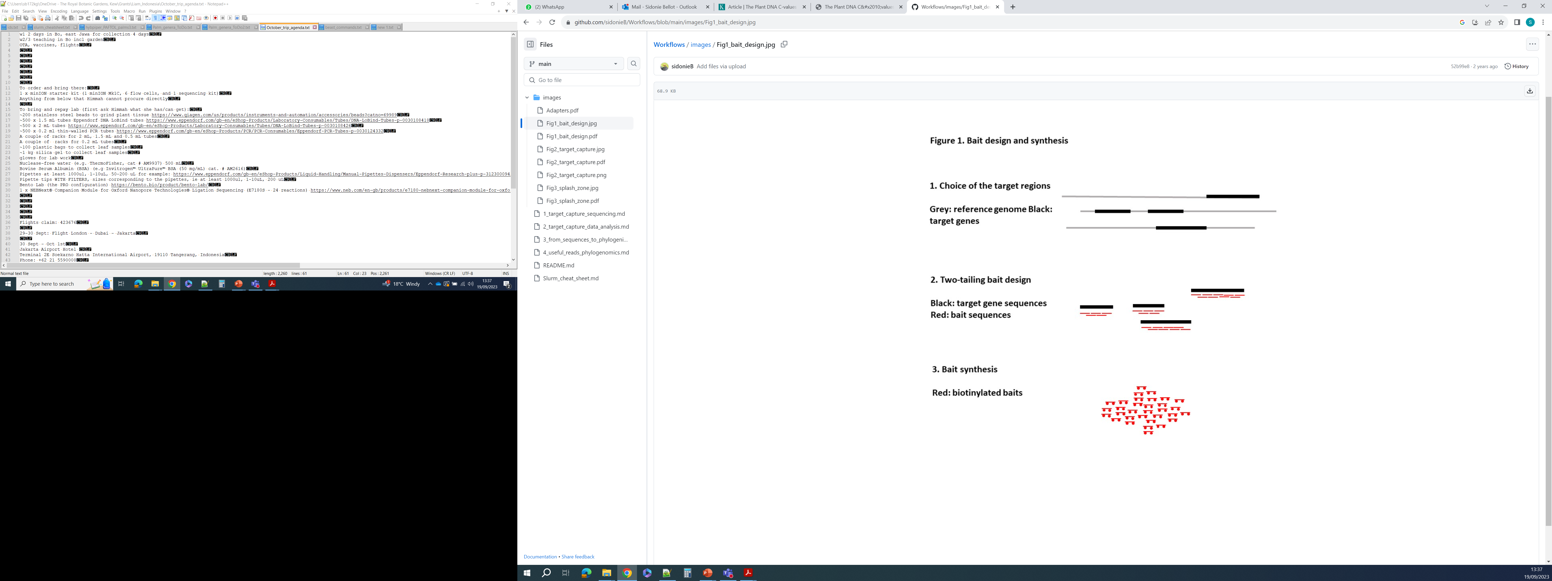
Target capture sequencing: the DNA library preparation is followed by a few more steps to capture target regions

Slide 5
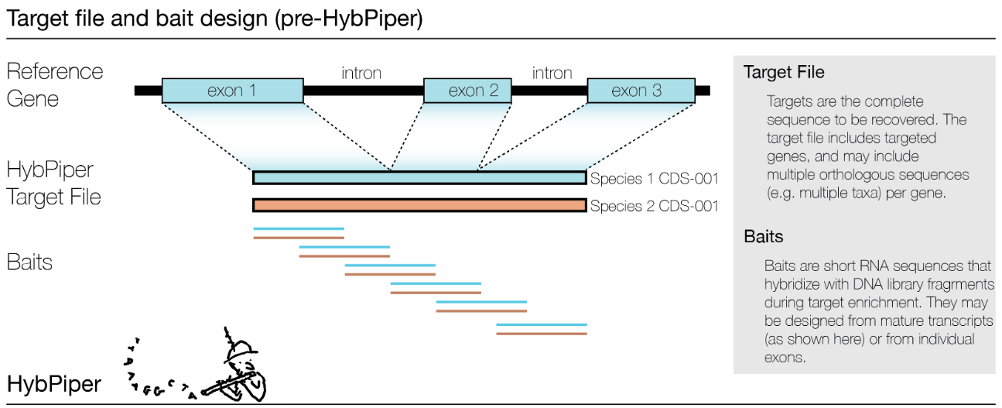
Hybpiper: a pipeline to assemble DNA regions from Illumina reads
https://github.com/mossmatters/HybPiper/wiki/ (M. Johnson, C. Jackson, N. Wickett, E. Gardner)
NB: there are other great pipelines, check out SECAPR (T. Andermann) and CAPTUS (E. Ortiz)

Slide 6
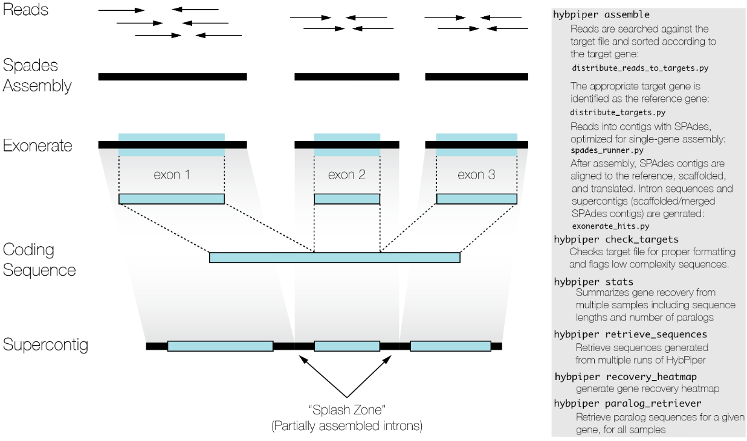
Hybpiper: a pipeline to assemble DNA regions from Illumina reads
https://github.com/mossmatters/HybPiper/wiki/ (M. Johnson, C. Jackson, N. Wickett, E. Gardner)
NB: there are other great pipelines, check out SECAPR (T. Andermann) and CAPTUS (E. Ortiz)

Slide 7
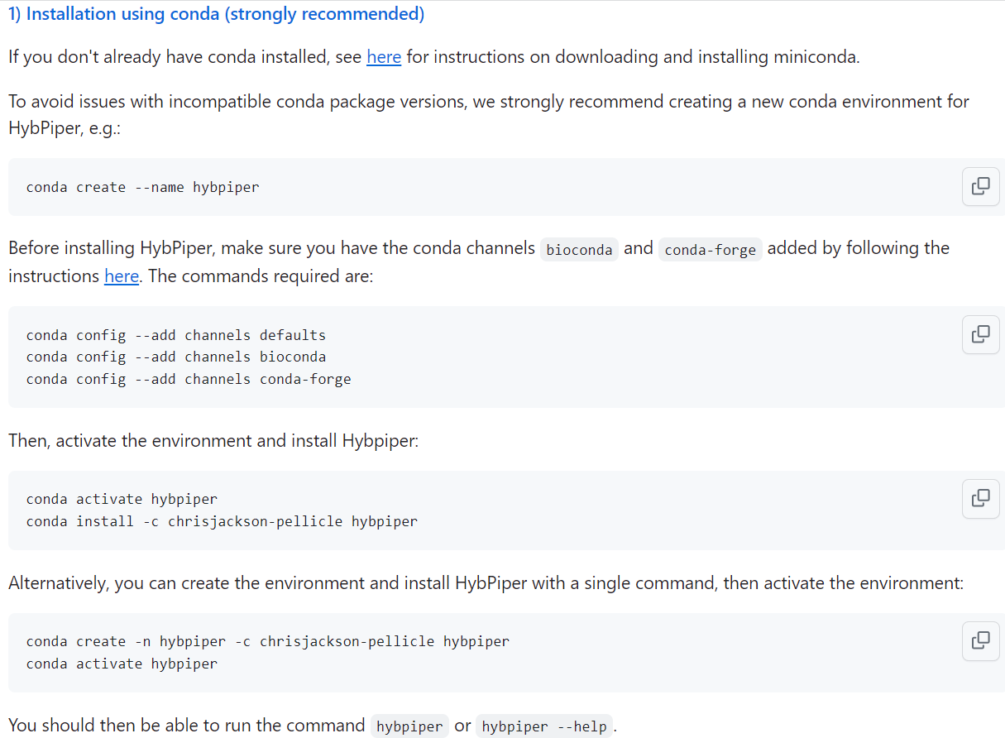
https://github.com/mossmatters/HybPiper/wiki/Installation

Slide 8
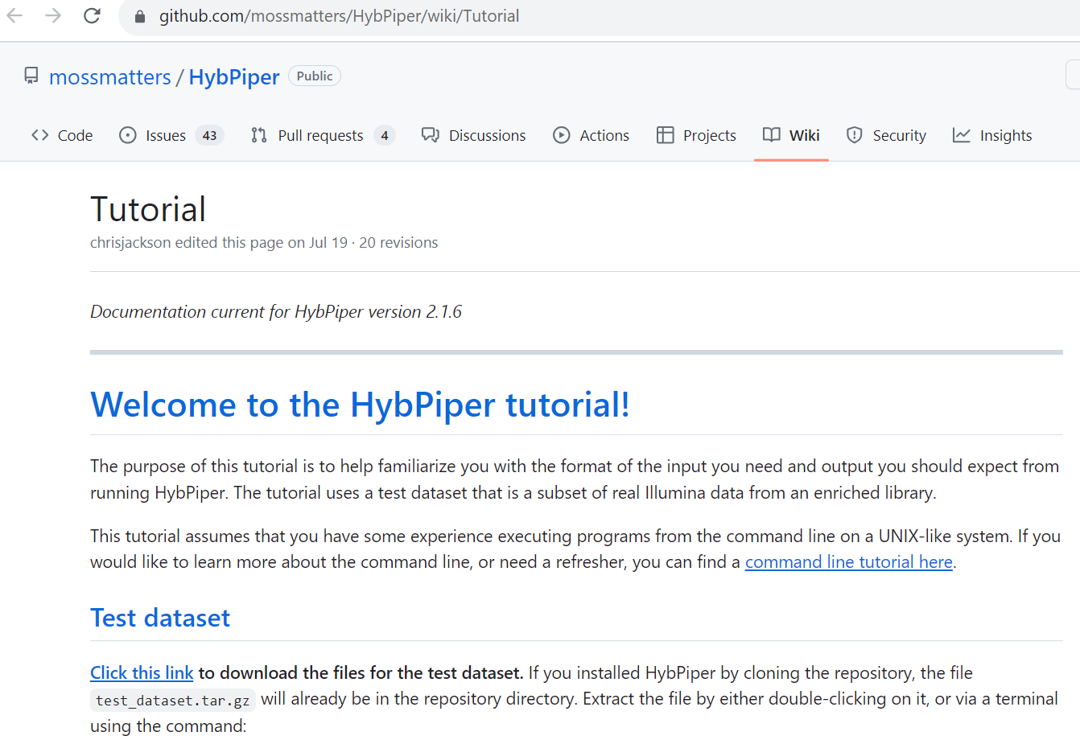
https://github.com/mossmatters/HybPiper/wiki/Tutorial

Slide 9
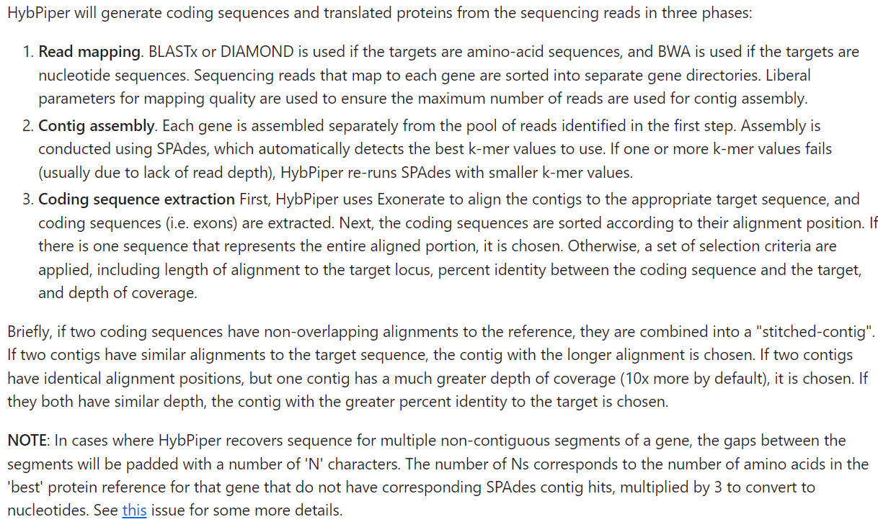
Read mapping (BLAST, DIAMOND or BWA)
Morus-gene1
Artocarpus-gene1
Gene1 reads
Morus-gene2
Artocarpus-gene2
Gene2 reads
Contig assembly (SPADES)
Gene1 reads
Gene1 contigs
Gene 2 reads
Gene2 contigs
Stitched contigs, contig choice
https://github.com/mossmatters/HybPiper/wiki/Tutorial
Artocarpus-gene2
Artocarpus-gene3
Coding sequence extraction (exonerate)
Intron sequence extraction
Artocarpus-gene3
Artocarpus-gene3-exon1
Artocarpus-gene3-exon2
Gene3 (super)contig
Splash zone
Gene2 contigs
Gene3 contigs
Gene3 contig
Splash zone
Gene2 stitched contig
Gene3 selected contig
Gene3 CDS (concatenated exons)
Gene3 concatenated introns (or unrecognized exons)

Slide 10
Let’s follow the Hybpiper tutorial to assemble genes
https://github.com/mossmatters/HybPiper/wiki/Tutorial

Slide 11

Makan Siang !

Slide 12
From gene sequences to gene trees
For each gene, combine the sequences of multiple samples in one file
supercontig files, or CDS files, or intron files
For each gene, align the sequences using MAFFT
Multiple sequence alignments
For each alignment, remove ambiguous sites (optrimAl), ambiguous sequences (CIAlign),
ambiguous sequence stretches (TAPER), and again ambiguous/gappy sites (optrimAl)
→ Clean alignments
For each clean alignment, find an appropriate nucleotide substitution model, and make a gene tree with bootstrap support values using IQtree
→ Gene trees with bootstrap support
Estimate a species tree based on the gene trees using ASTRAL, and root it using phyx
→ Rooted species tree with local posterior probabilities

Slide 13
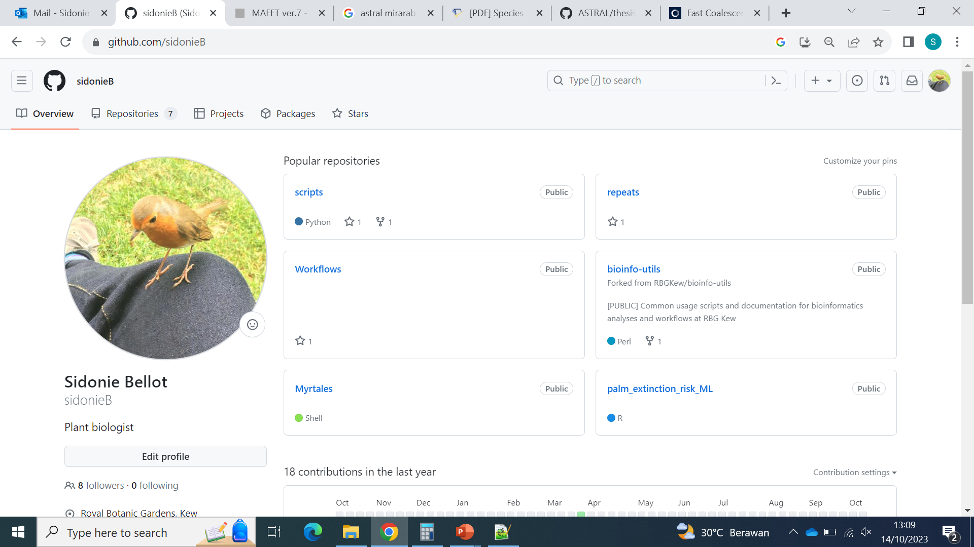
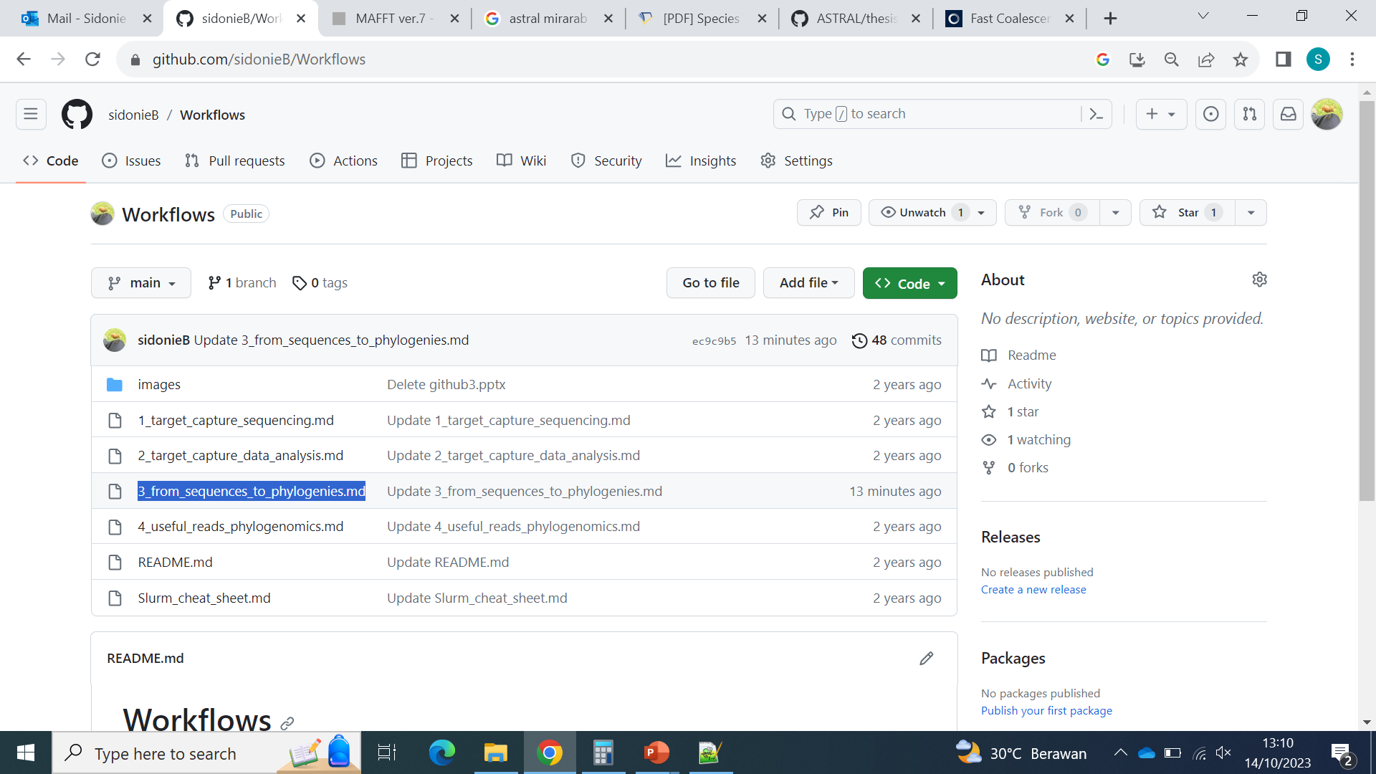
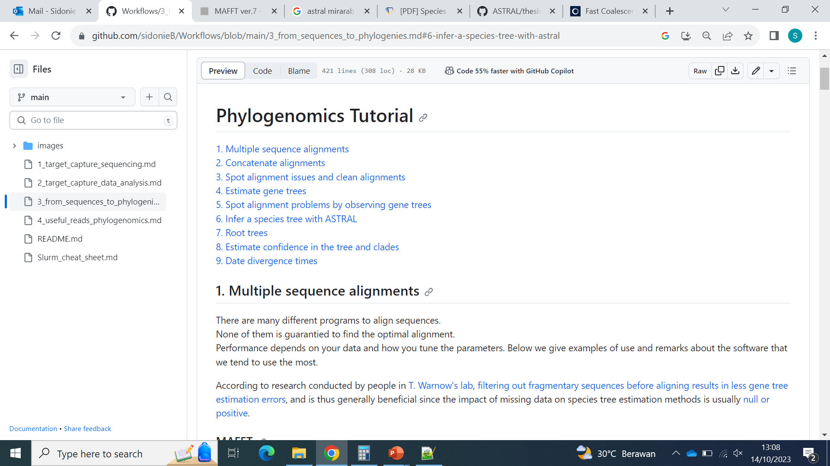

Slide 14
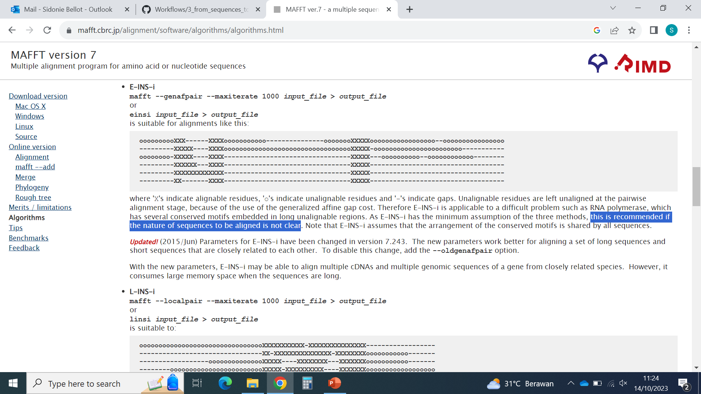
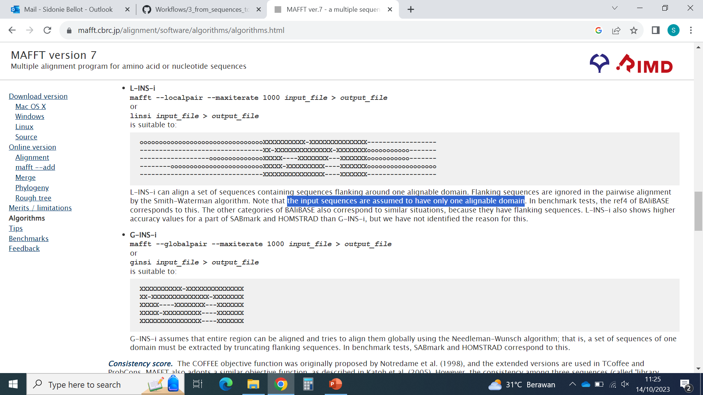
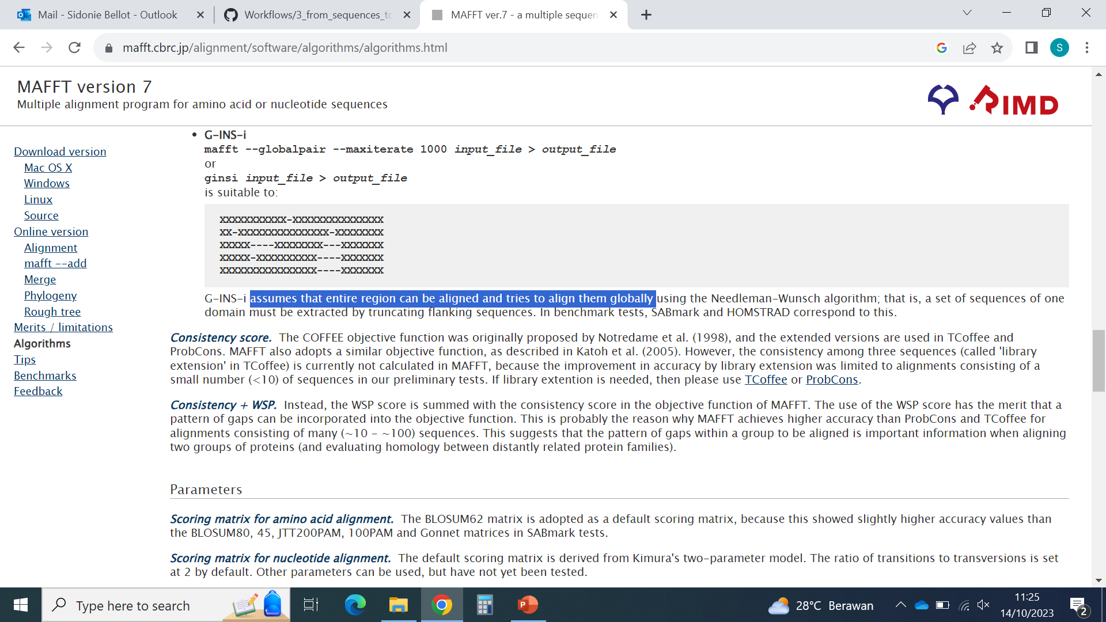
Multiple sequence alignment

Slide 15
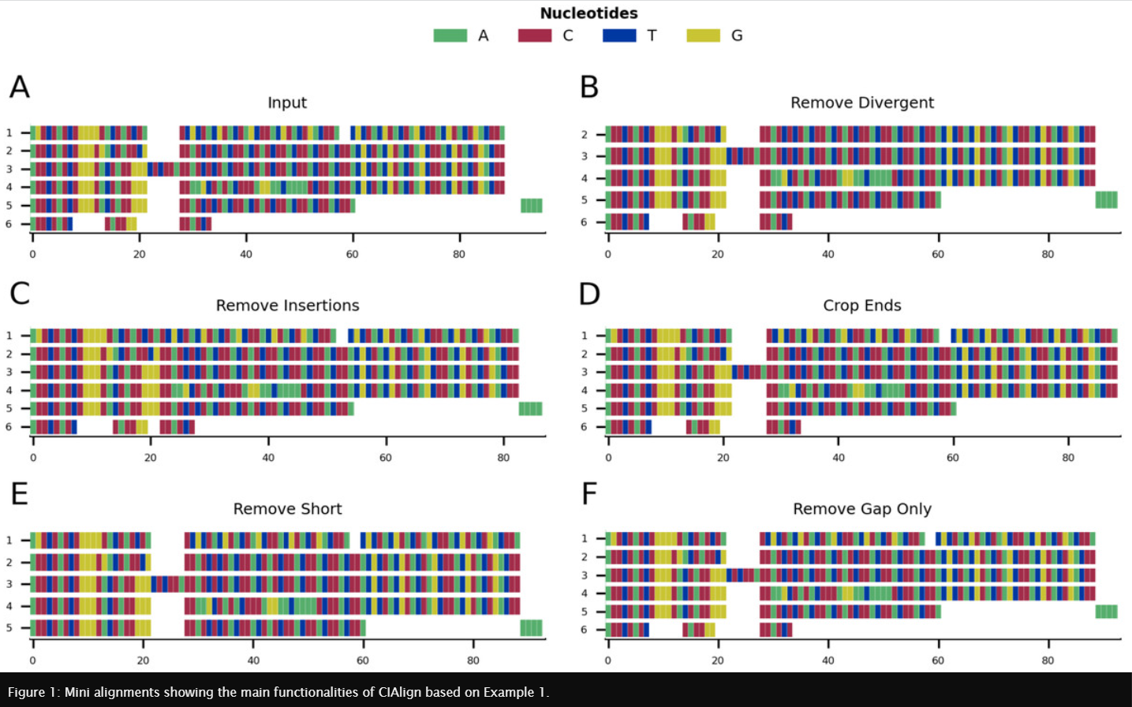
Alignment cleaning & selection
Tumescheit, Firth & Brown, PeerJ, 2022: CIAlign

Slide 16
Day 6 - Let’s make sure we are ready for the final steps
We need:
IQtree
ASTRAL (preferably weighted ASTRAL)
R (ideally with RStudio)

Slide 17
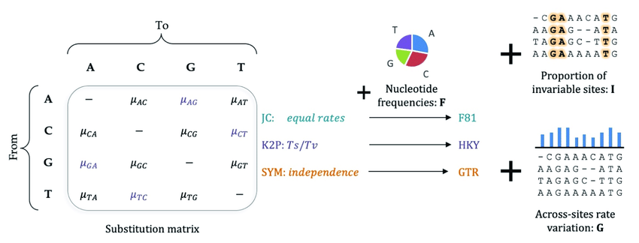
Models of nucleotide substitution
© Shiran Abadi, available on ResearchGate

Slide 18
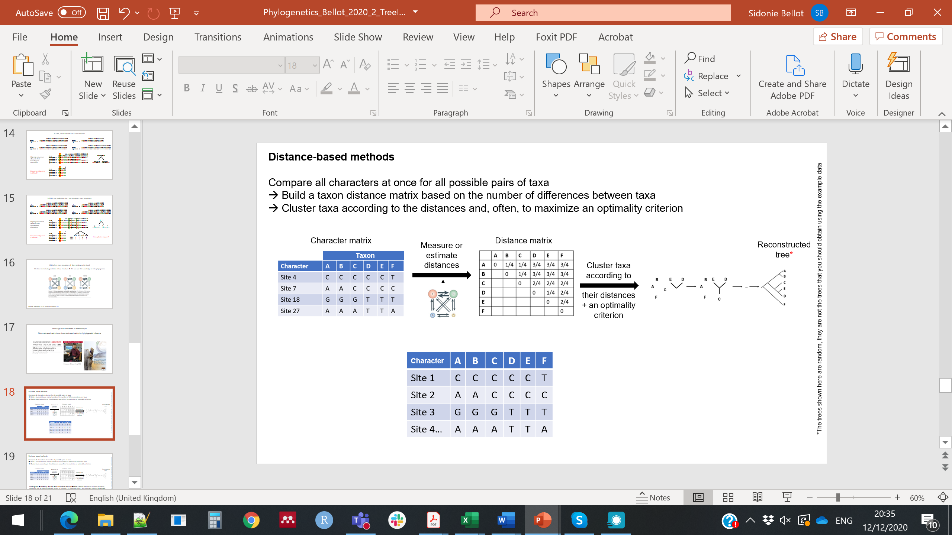
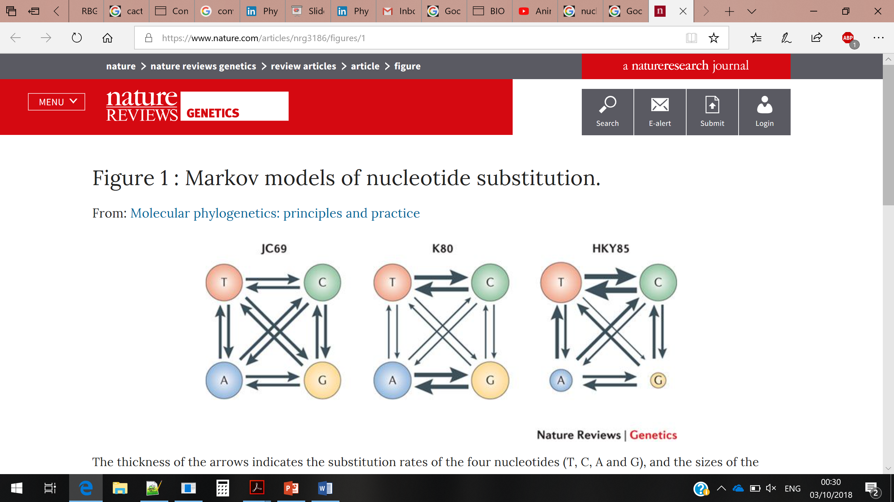
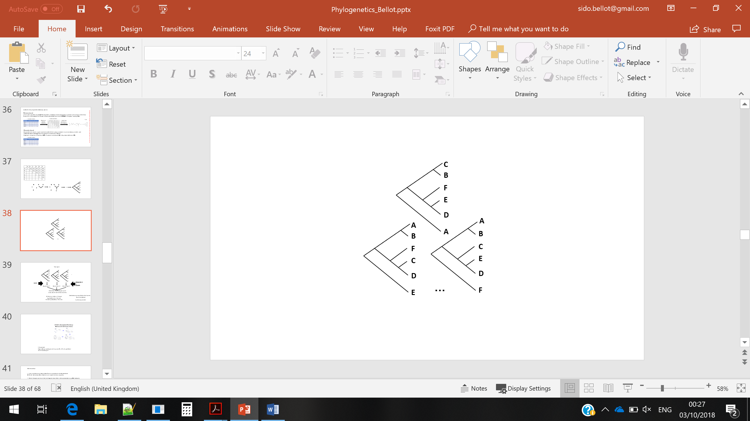
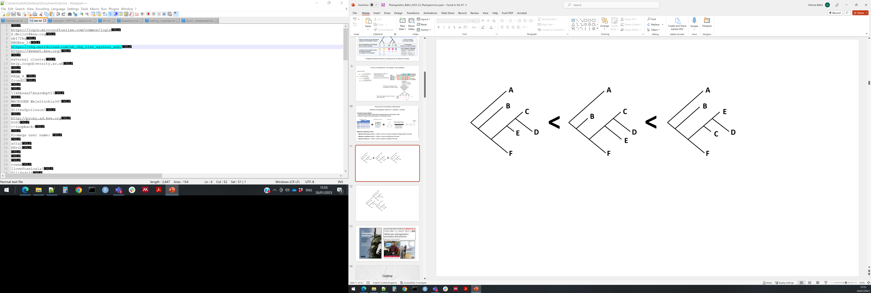
Estimating gene trees
Character-based methods
Optimize branch lengths of alternative topologies based on evolutionary model
2. Select the highest scoring tree based on an optimality criterion
Character matrix
Evolutionary model
Tree space
Taxon
Selected tree*
+
+
Optimize trees following the evolutionary model
Score and rank trees according to optimality criterion
*The trees shown here are random, they are not the trees that you should obtain using the example data
Methods & optimality criteria:
Maximum Parsimony – Criterion: minimum number of character changes (minimum tree length)
Maximum Likelihood – Criterion: maximum tree log-likelihood
Bayesian Inference – Criterion: maximum tree posterior probability

Slide 19
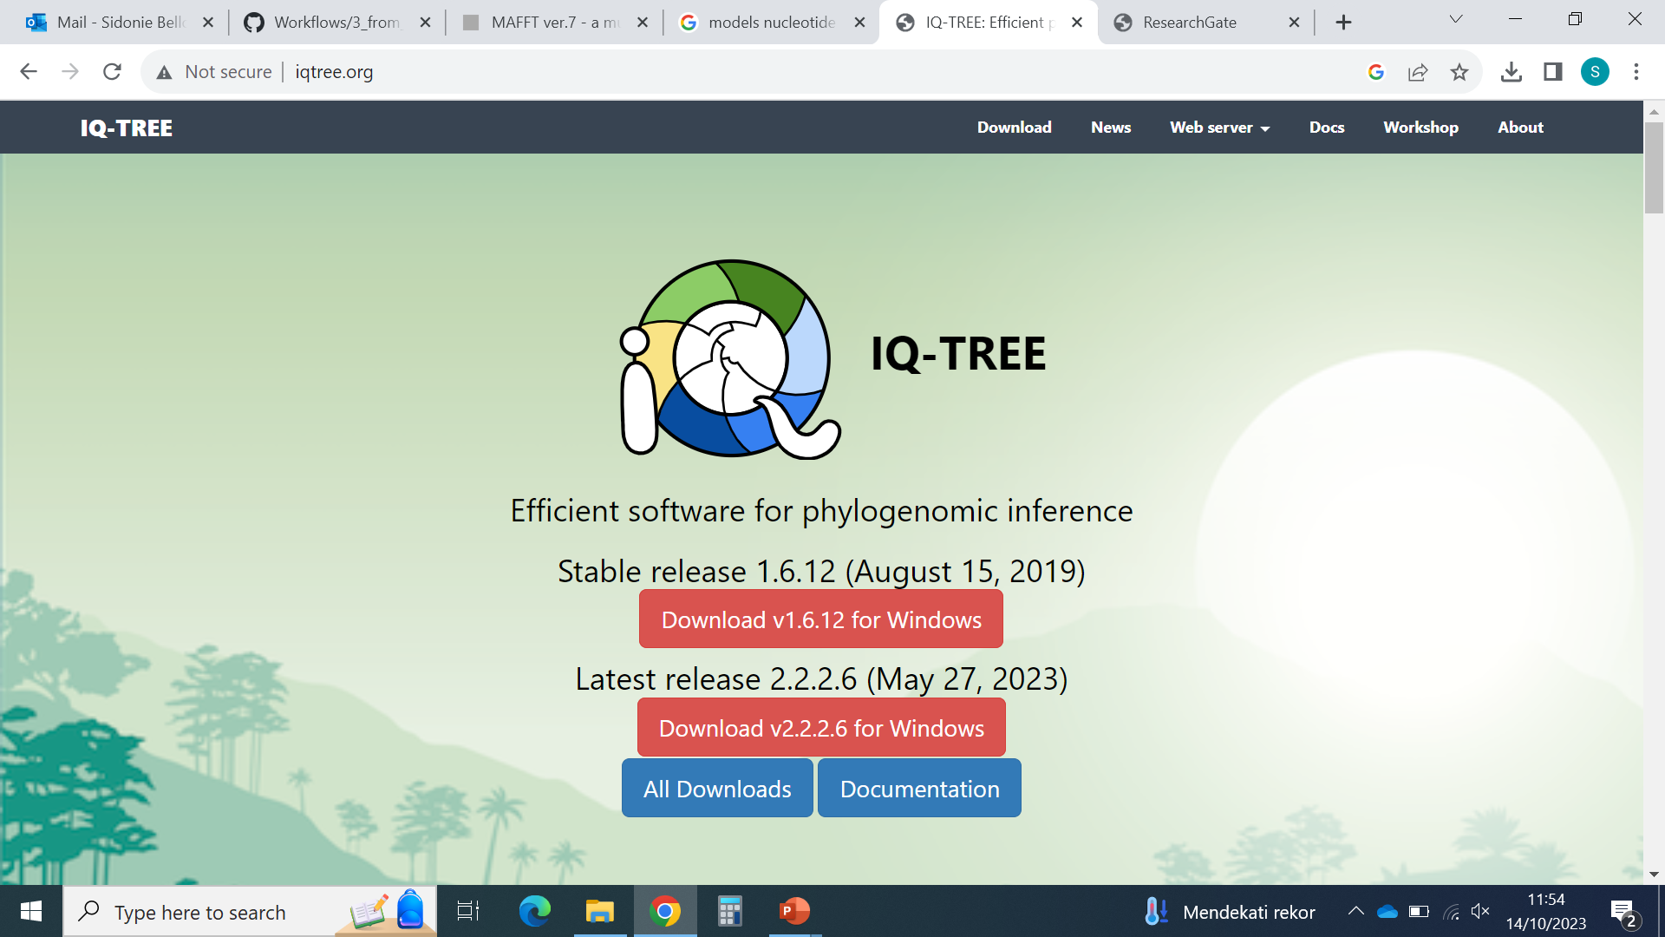
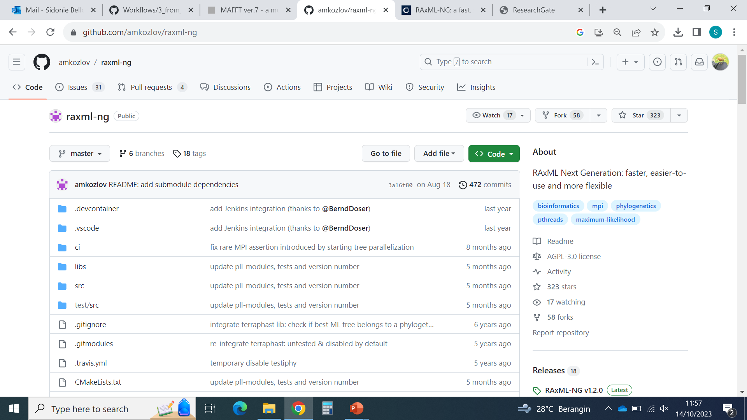
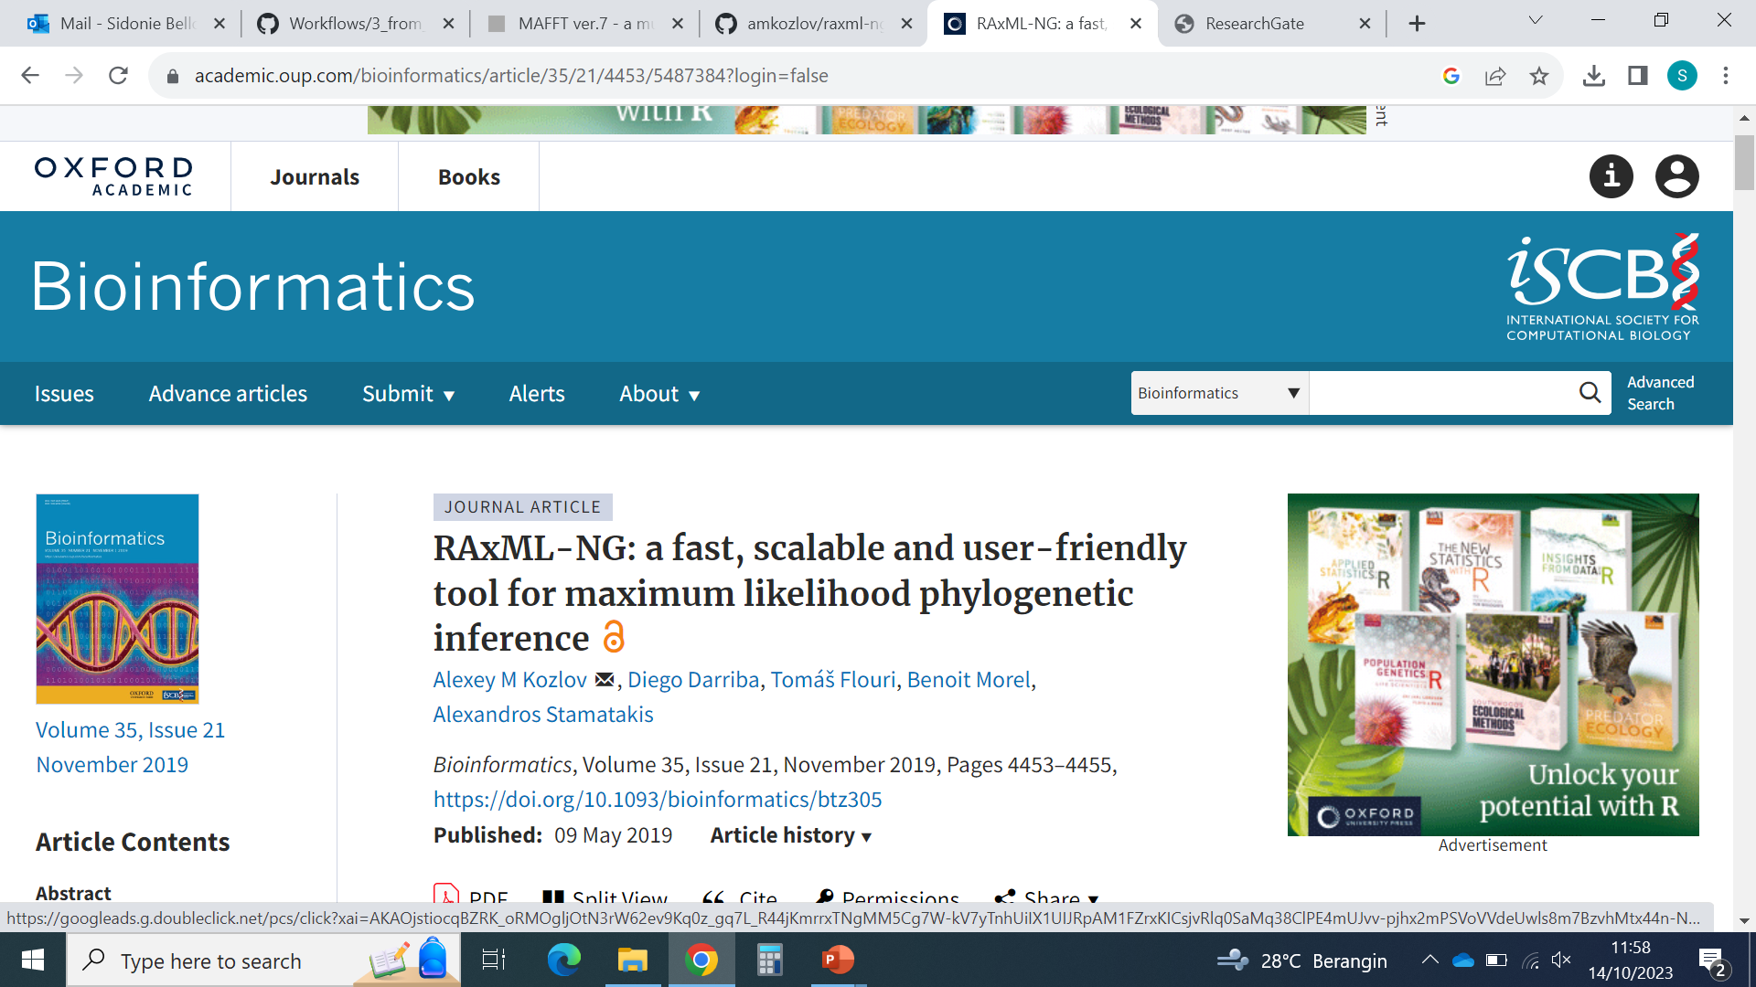
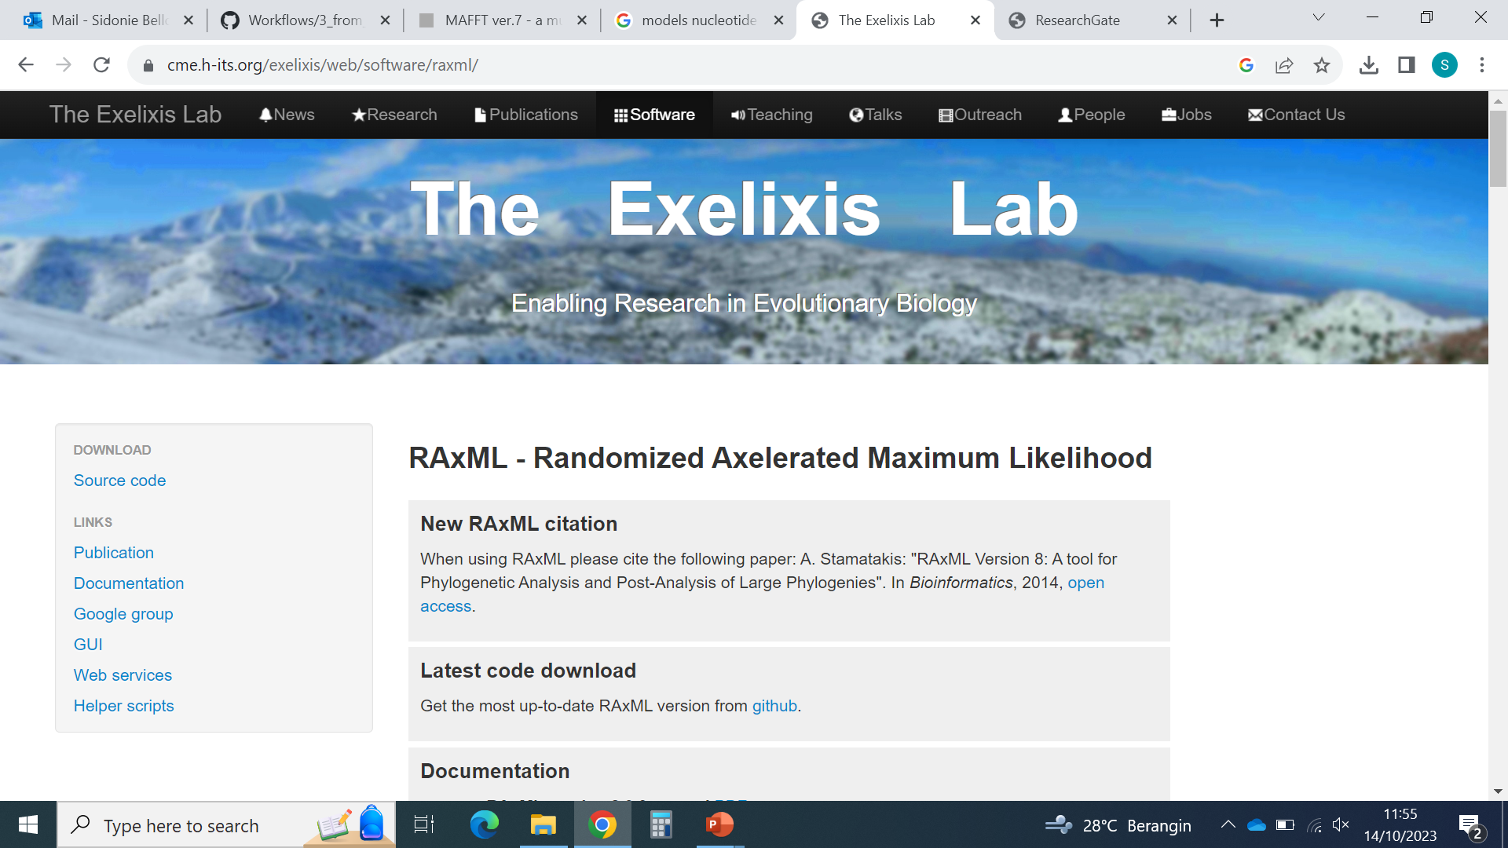
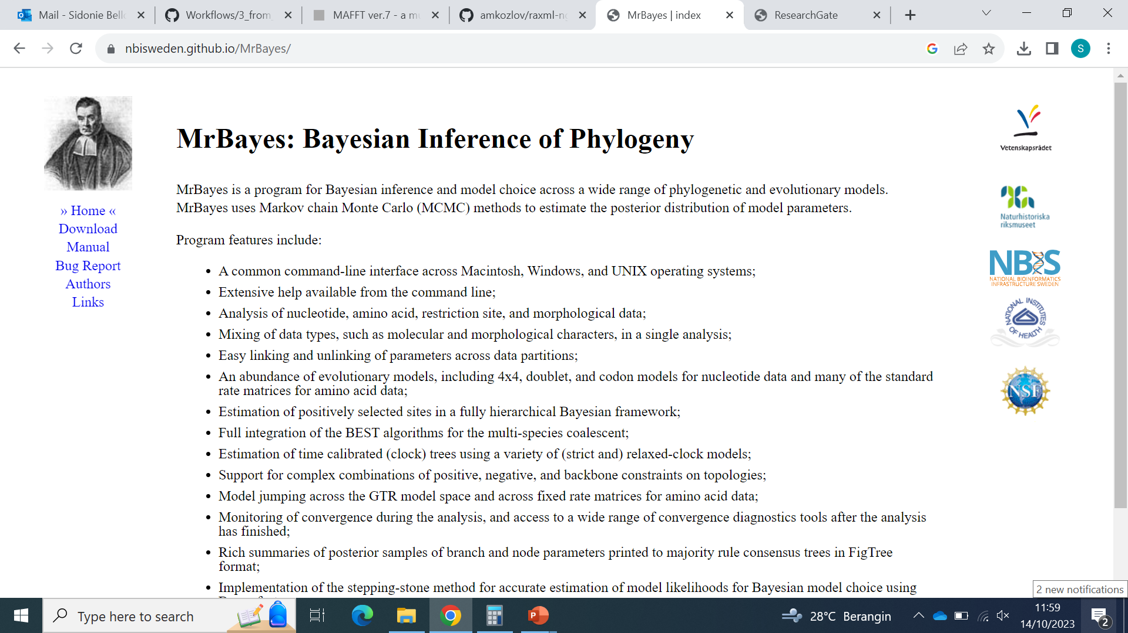
Estimating gene trees

Slide 20
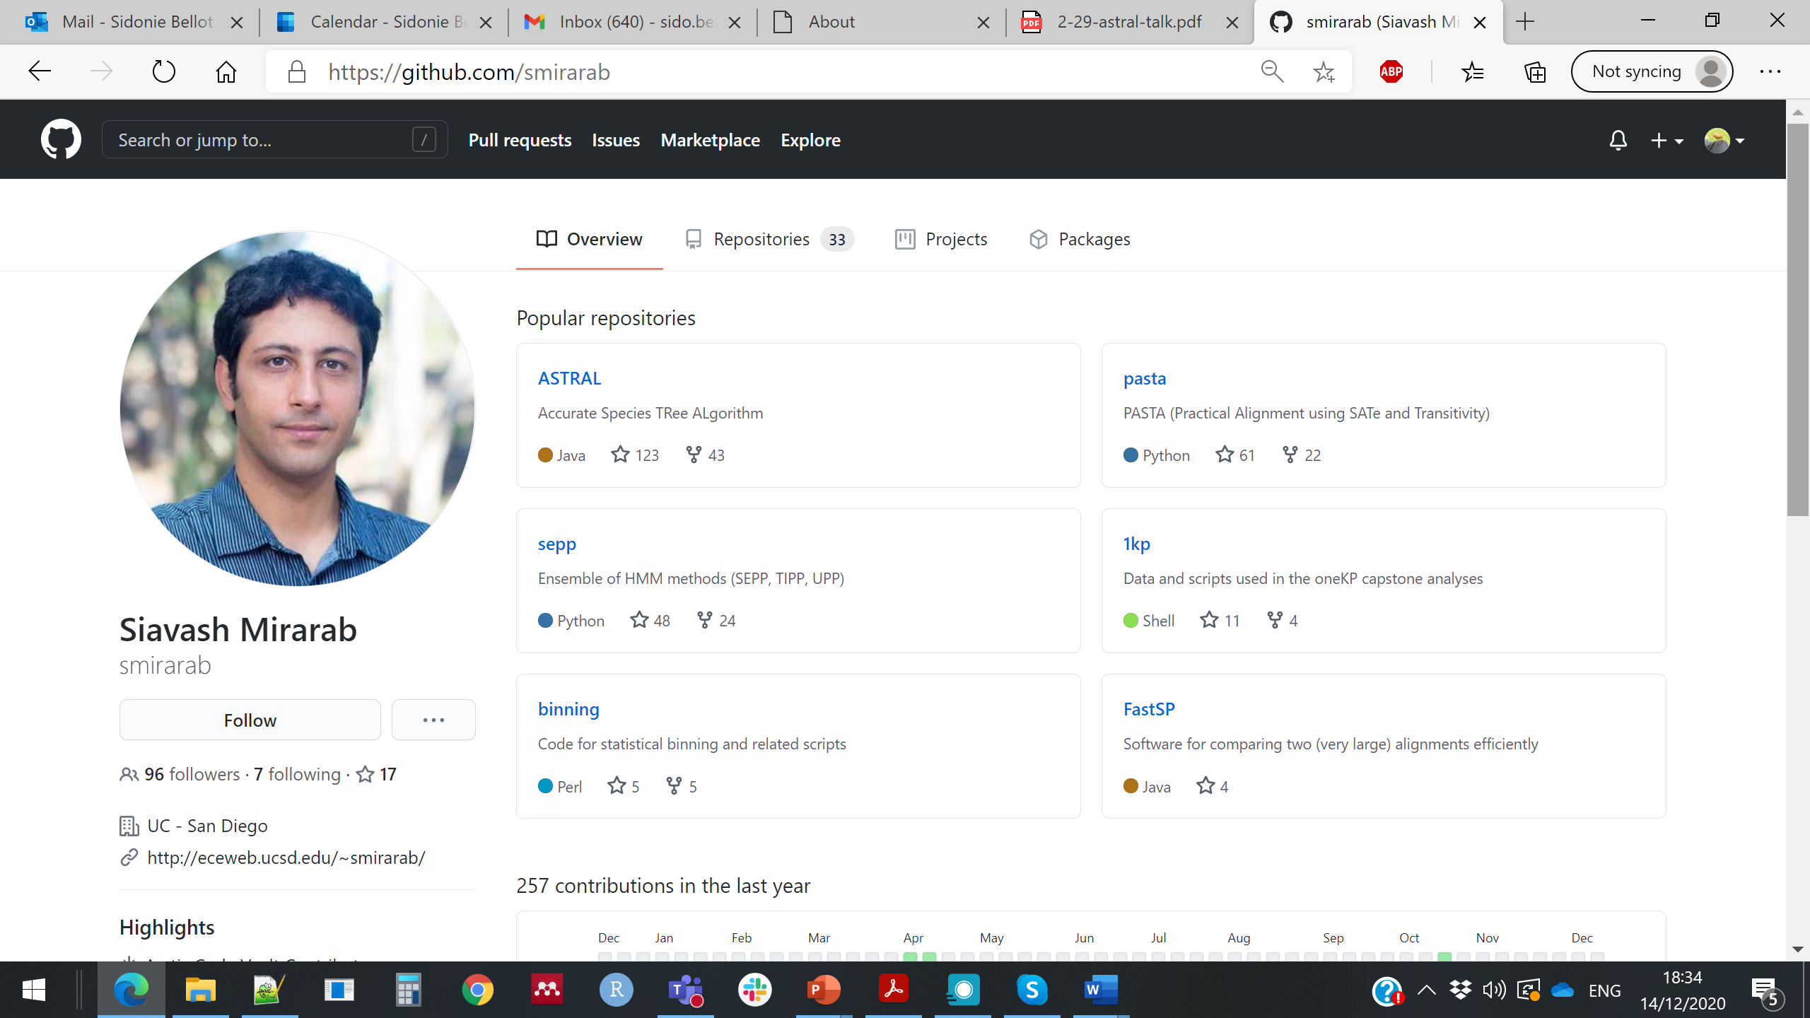
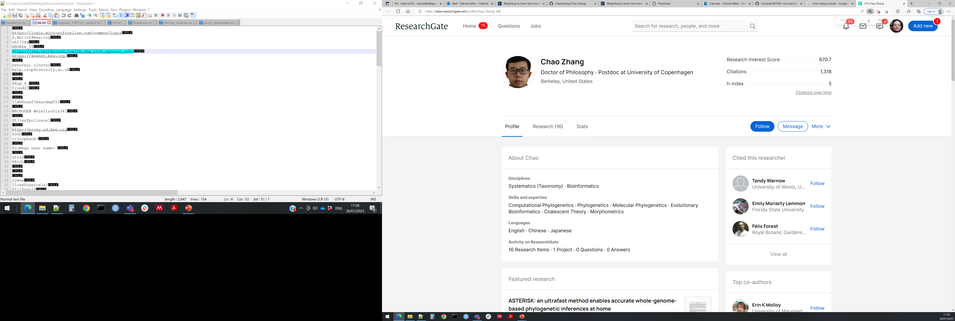
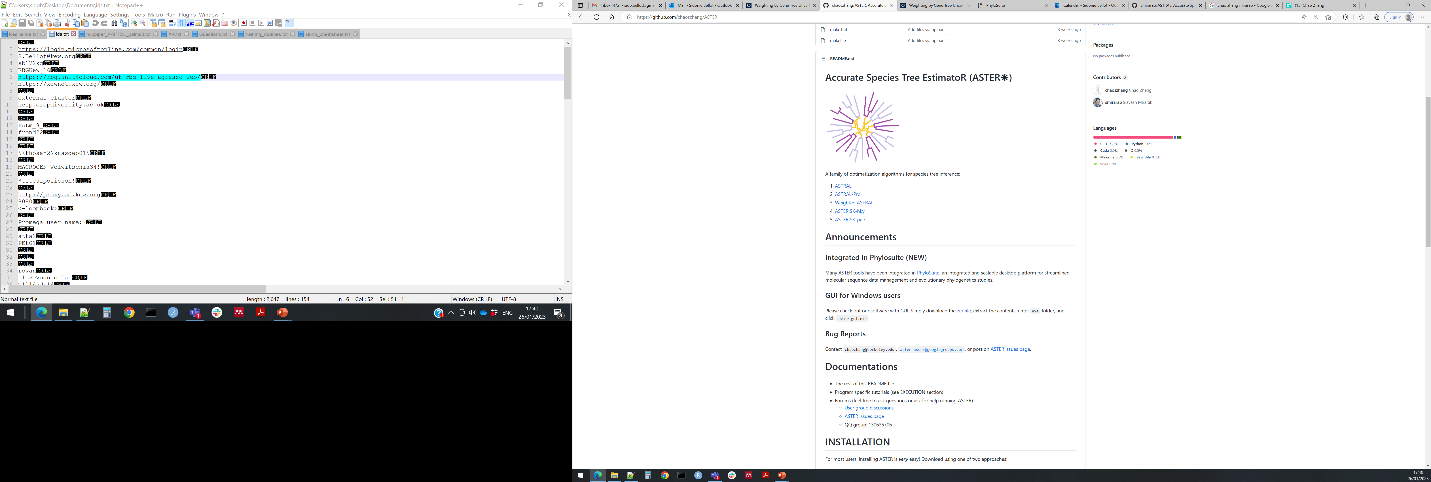
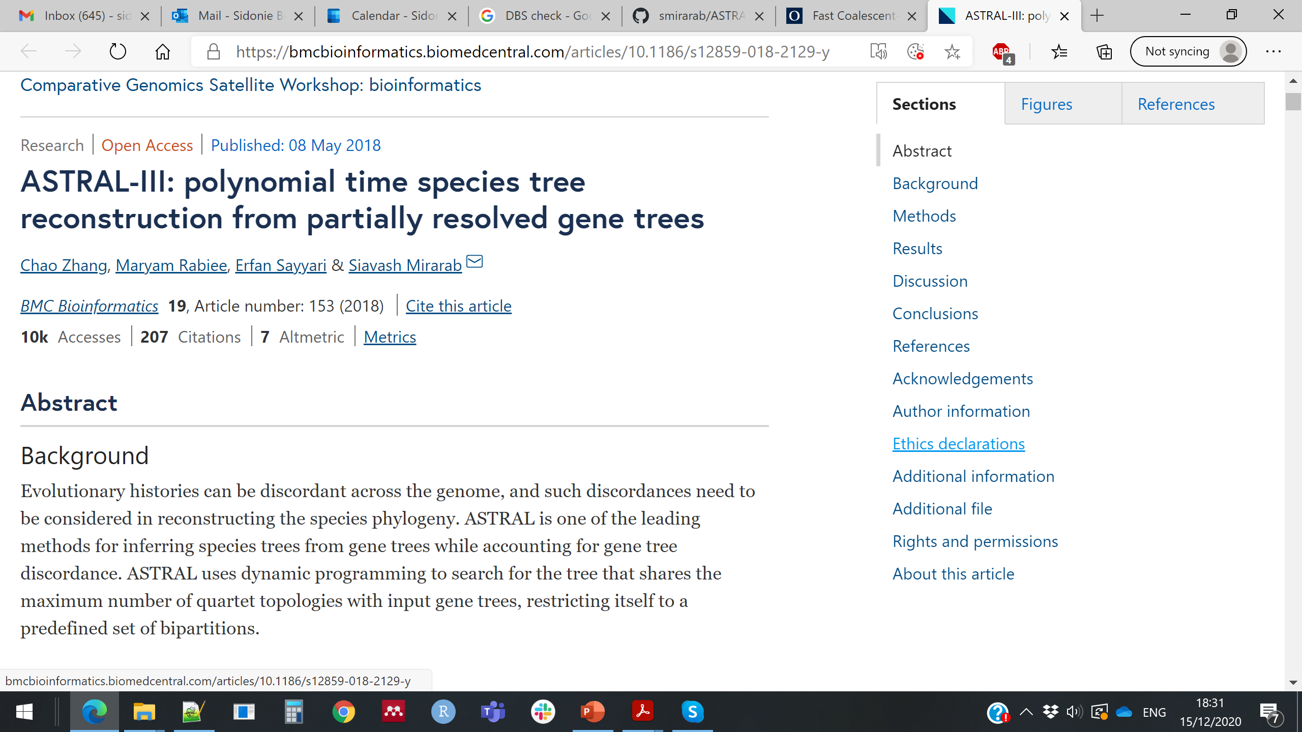
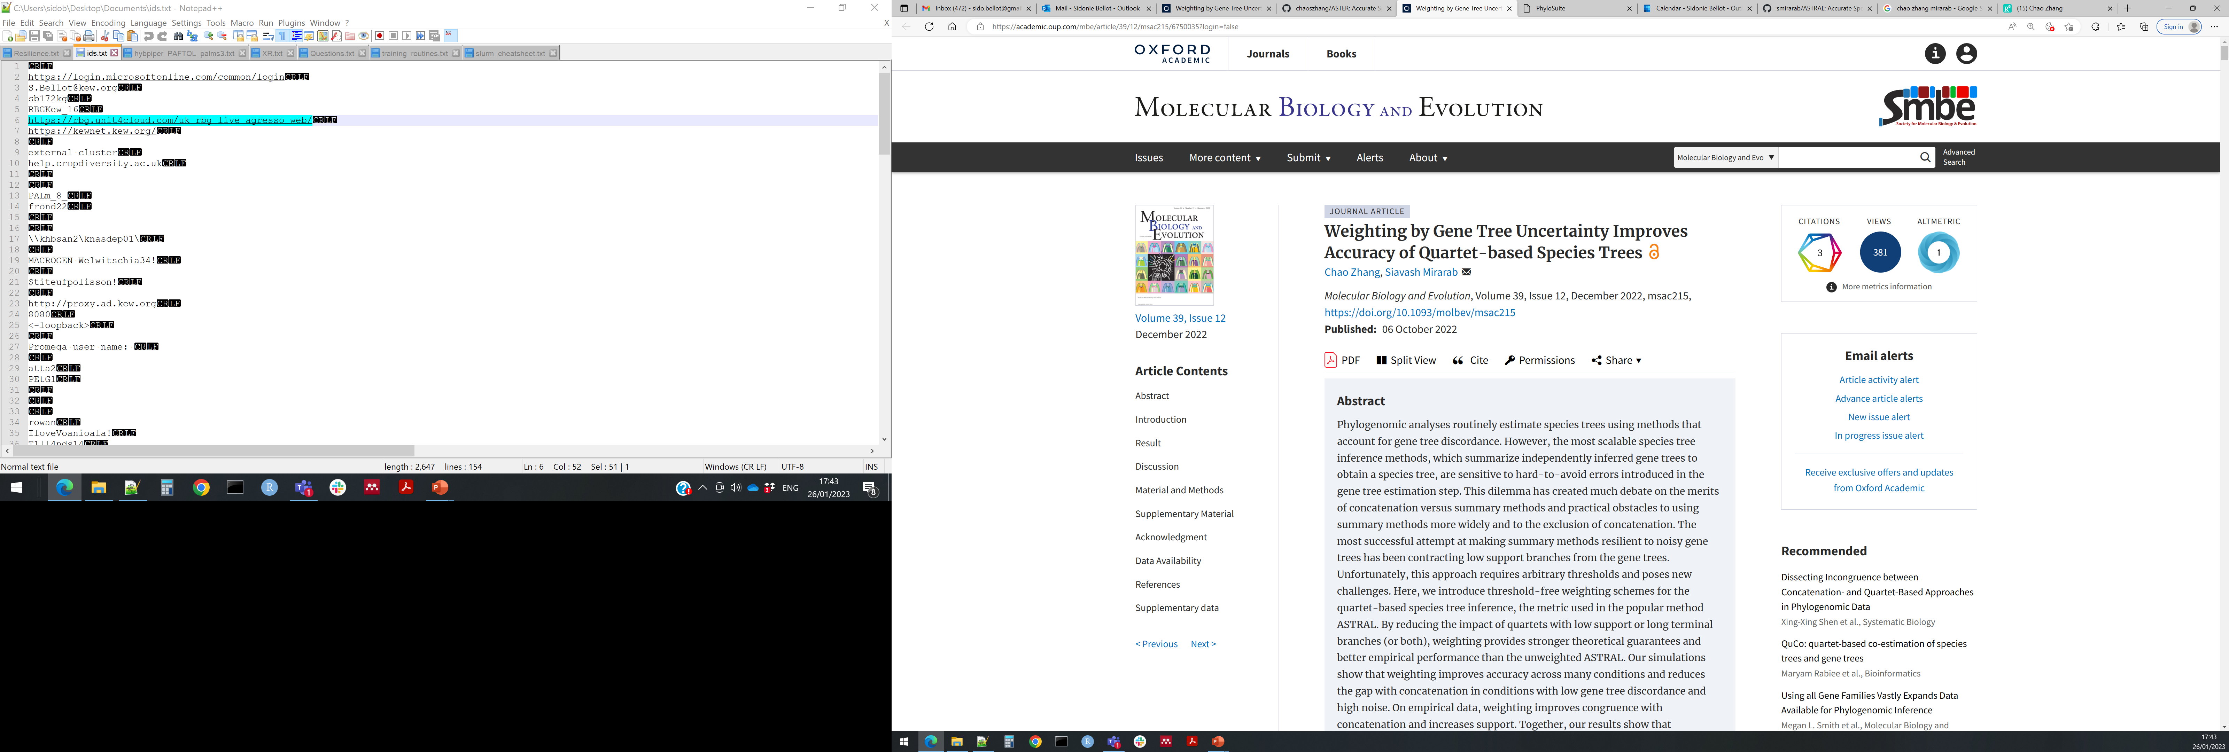
Estimating a species tree with ASTRAL
Sequence alignments
+
Models of evolution
Gene trees
Quartets extracted from each gene tree
Phylogenetic inference statistically consistent with the MultiSpecies Coalescent
Species tree supported by the highest number of quartets found in the gene trees
(given a constrained tree space)
Mirarab slides on ASTRAL: http://eceweb.ucsd.edu/~smirarab/assets/2017-astral-evolution.pdf

Slide 21
Look at the species tree and branch support
plot_Astral_trees_v4_small_tree.R
How confident can we be in the different clades in our tree?
See phylogenomics lecture, part 4. Confidence

Slide 22
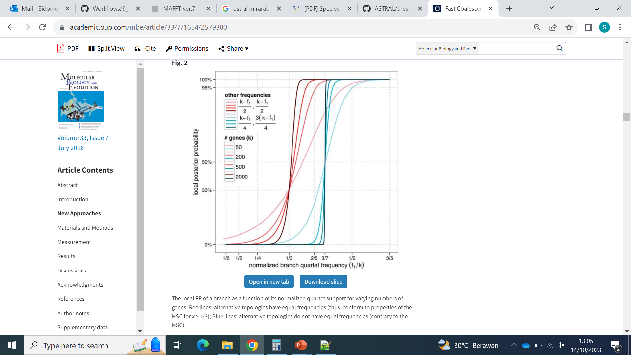
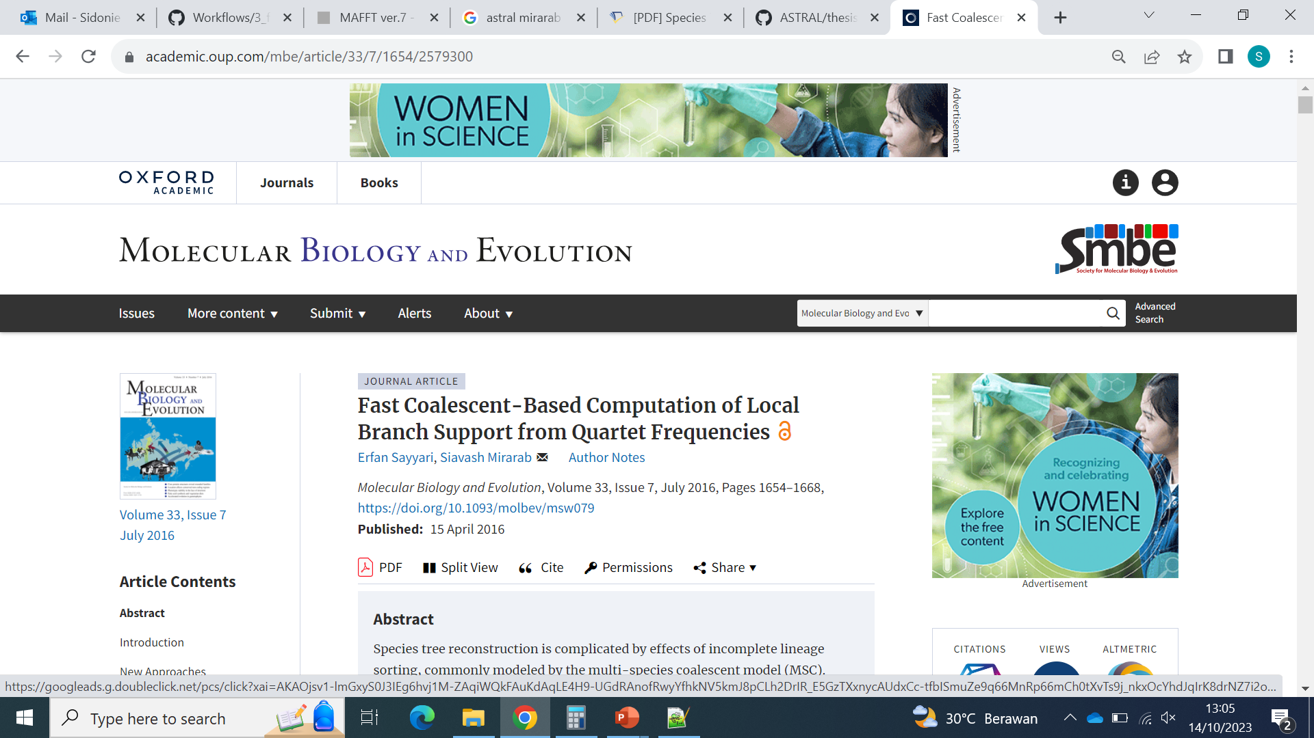
More info about ASTRAL support and branch lengths in this paper:

Slide 23
Oxford Nanopore Sequencing Introduction

